Slide 1
Product management app using the Django framework

Slide 2
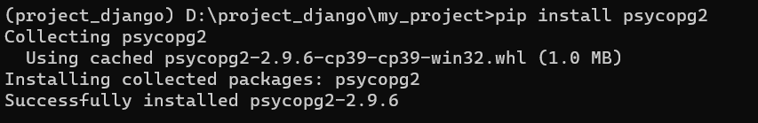
Open command prompt (windows+r) →cmd →enter
Change the directory in which you want to create environment
Install virtual environment by using the following command
pip install virtualenv
Give name to the environment
virtualenv (environment name)
Installl Django and psycopg2
Create a project in the created environment
Change your directory to the project
Create an app here my app name is products

Slide 3
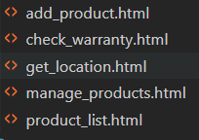
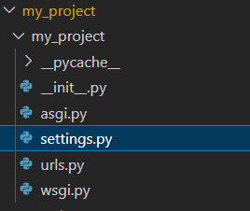
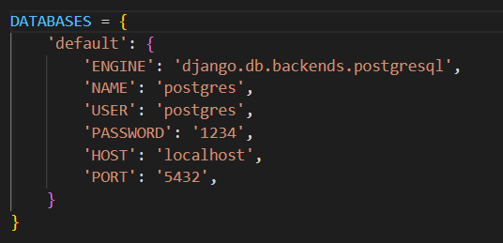
Now create a directory named templates in the products (app directory)
In the templates directory crete all the html files required for our project ie
Now make necessary changes in the settings.py file from my_project directory
Make changes in the database
Give the details of your postgresql database

Slide 4
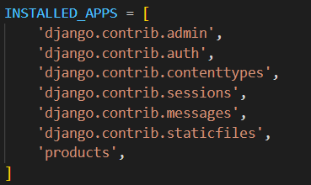
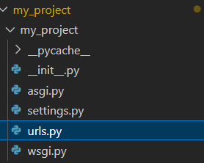
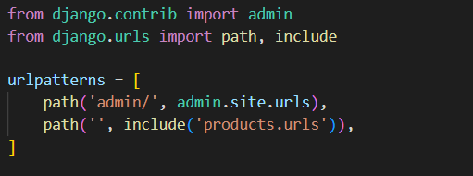
In the installed apps add the app you created
Change the urls.py file
Also in the html files change coding according to your requirements

Slide 5

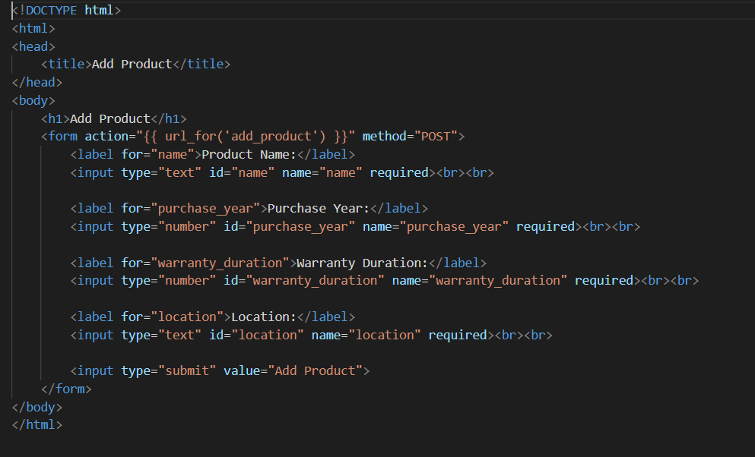
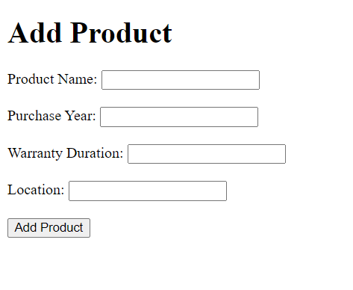

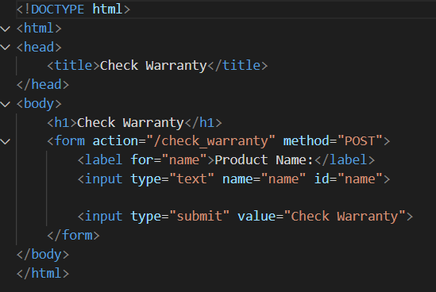
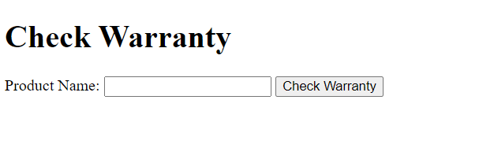

Slide 6

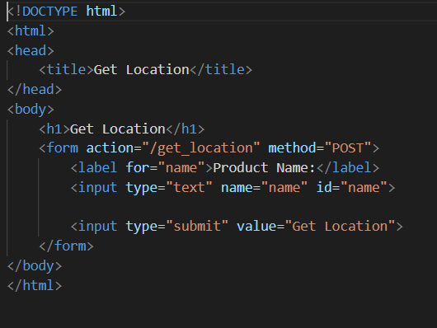
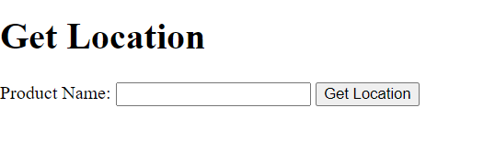
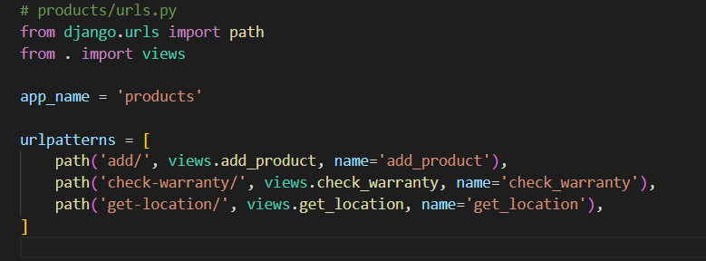
Now change the apps urls.py file to open those particular html files

Slide 7

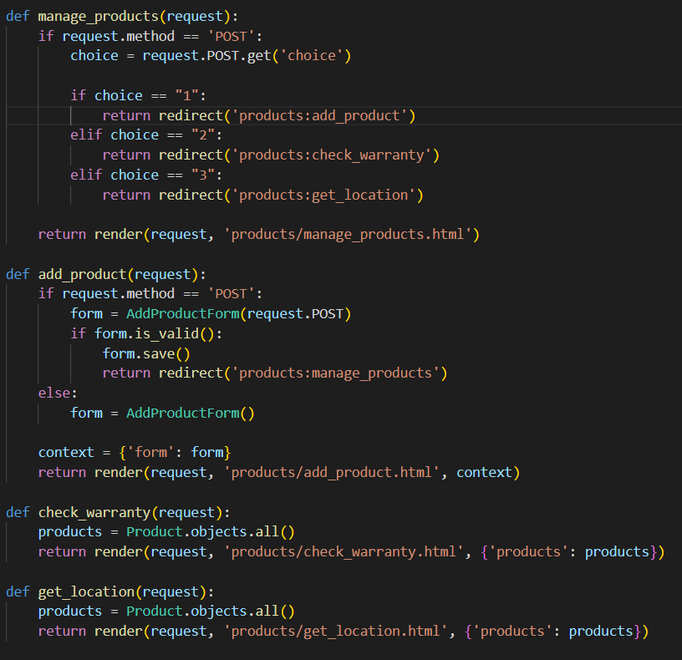
Insert these modules in the views.py file in products app
render function is used to render HTML templates and return an HttpResponse
redirect function is used to redirect the user to a different URL
And then define the functions of your code

Slide 8
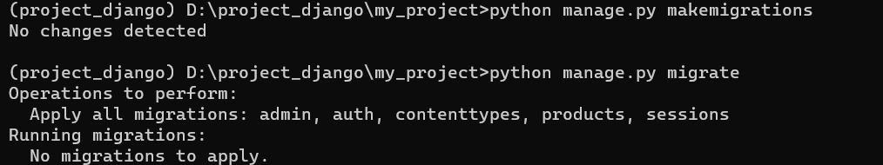
In Django, manage.py makemigrations and manage.py migrate are commands used to handle database migrations.
By running these commands, you ensure that the database schema stays synchronized with the models defined in your Django project.

Slide 9
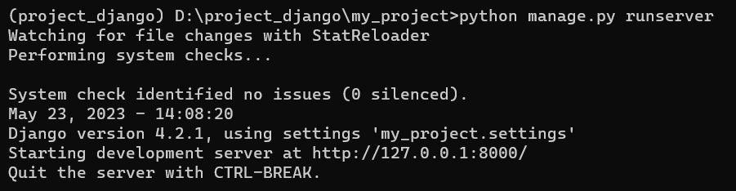
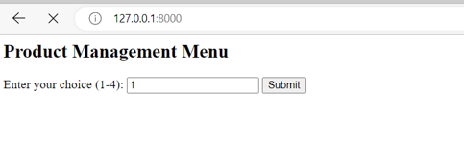
In order to launch a web server that serves your Django application locally. Use the following command
Click this link the product management menu will open as shown below

